Slide 1
Qlik Sense

Slide 2
Qlik Sense
Qlik Sense is a Business Intelligence (BI) and data analytics tool used to connect data from different sources, analyze information, create interactive dashboards, and make better business decisions.
Qlik sense is self service analytical plotform
It helps users convert raw data into meaningful insights using charts, tables, KPIs, filters, and visualizations.
Qlik Sense helps us:
  Connect data from multiple sources.
  Clean and transform data.
  Create interactive dashboards and reports.
  Identify trends and patterns.
  Analyze data using filters and selections.
  Support business decision-making.

Slide 3
Qlik Sense Features
1. Data Manager
A visual interface for loading, preparing, and associating data from different sources with minimal scripting.
2 Data Load Editor
Used to write load scripts for loading, transforming, joining, and aggregating data.
3 Associative Engine
Allows users to explore relationships between data interactively. Selecting one value updates related visualizations and reveals associated and unrelated values.
4. Interactive Dashboards
Create charts, KPIs, tables, filter panes, and visual reports for analysis.

Slide 4
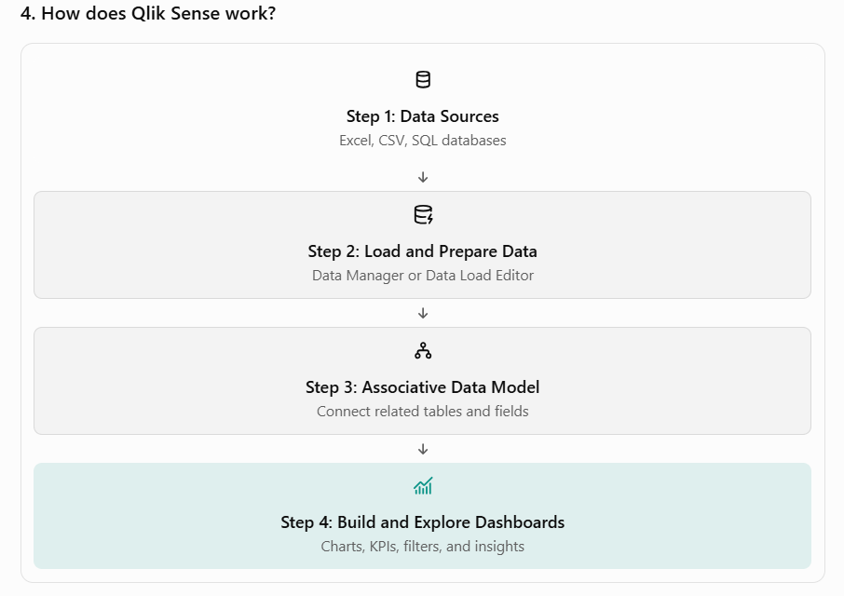

Slide 5
How is Qlik Sense different from other BI tools?
Qlik Sense is a Business Intelligence (BI) tool, similar to Microsoft Power BI and Tableau. All three tools help organizations connect data, create dashboards, analyze trends, and make business decisions.
The main difference is Qlik Sense's associative engine, which allows users to explore relationships across data interactively, including discovering values that are not associated with their current selections.

Slide 6
How is Qlik Sense different from other BI tools?
Qlik Sense is a Business Intelligence (BI) tool, similar to Microsoft Power BI and Tableau. All three tools help organizations connect data, create dashboards, analyze trends, and make business decisions.
The main difference is Qlik Sense's associative engine, which allows users to explore relationships across data interactively, including discovering values that are not associated with their current selections.

Slide 7
QlikView
QlikView is a Business Intelligence (BI) and data visualization tool developed by Qlik. It helps organizations collect data from different sources, analyze information, and create interactive reports and dashboards.
QlikView is known for its guided analytics approach, where developers design reports and applications that users can explore interactively.
Why do we use QlikView?
  Connect to Excel files, text files, and databases.
  Load and transform data using scripts.
  Create charts, tables, and dashboards.
  Analyze sales, finance, inventory, and student performance.
  Explore relationships between data using selections.
  Support business decision-making.

Slide 8
Qlik Sense Vs Qlik View
Feature | QlikView | Qlik Sense
Analytics approach | Guided analytics | Self-service and exploratory analytics
Interface | Classic, developer-designed | Modern, responsive interface
Dashboard creation | More developer-driven | Visual, drag-and-drop design
Data scripting | Supported | Supported
Associative engine | Yes | Yes
Mobile experience | More traditional | Designed for modern responsive use

Slide 9
What is Associative Search in Qlik Sense?
Associative Search is a feature in Qlik Sense that helps users search for values across fields and explore relationships between data, even when the search term is not in the currently selected field.
Qlik Sense uses its Associative Engine to identify related and unrelated values based on the current selections.
For example, suppose you have sales data with these fields:
  Category
  Country
  OrderID
  Product
  Region
  Sales
You can search for a product, country, or category and explore the associated sales information interactively.

Slide 10
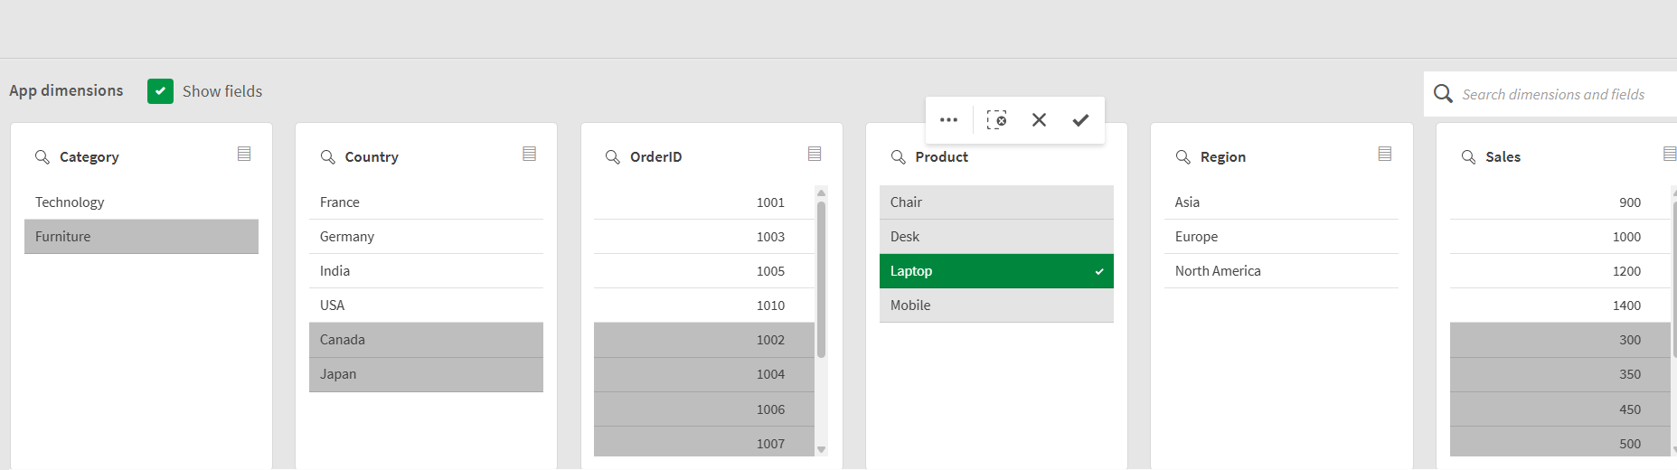
What is Associative Search in Qlik Sense?
1. Green — Selected value
Laptop is selected in the Product field. This is the active selection that Qlik uses to filter the associated data.
2. White — Possible values
Values that remain possible based on the current selection. For example, the visible countries France, Germany, India, and USA are possible with the selected Laptop product.
3. Gray — Excluded values
Values that do not match the current selection. In your screenshot, Furniture is gray, indicating it is excluded by the current selection.

Slide 11
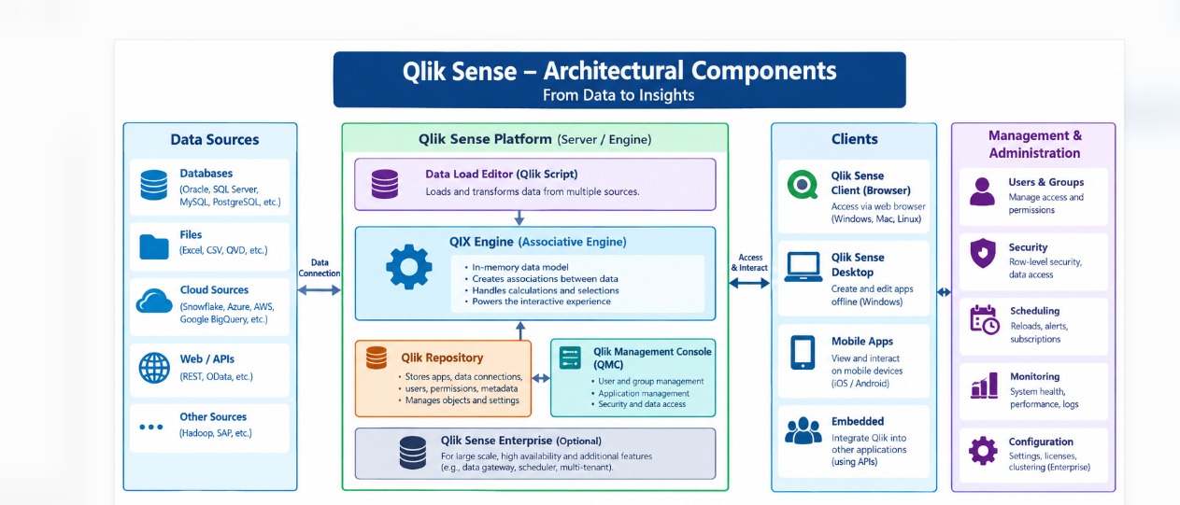
Qlik Sense Architectural Components

Slide 12
Qlik Sense Architectural Components
1. Data sources
Qlik Sense connects to multiple data sources:
  Databases: SQL Server, Oracle, MySQL
  Files: Excel, CSV, QVD
  Cloud platforms: Snowflake, Azure, Amazon Web Services
  Web services and APIs
  Purpose: Collect data for analysis.
2. Data Load Editor
The Data Load Editor is used to write Qlik script to extract, transform, and load data.
Purpose: Load and transform data before analysis.

Slide 13
Qlik Sense Architectural Components
3 QIX Engine (Associative Engine)
The QIX Engine is the core analytical engine of Qlik Sense.
Its responsibilities include:
  - Building the associative data model.
  - Processing selections and filters.
  - Performing calculations and aggregations.
  - Supporting interactive visualizations.
  - Identifying possible and excluded values.
Example: When you select Product = Laptop, the engine updates the associated values in Country, Region, OrderID, and Sales.
4. Qlik Repository
In Qlik Sense Enterprise on Windows, the Qlik Repository Service (QRS) manages and stores information about applications, data connections, users, permissions, and other repository objects.

Slide 14
Qlik Sense Architectural Components
5 Qlik Management Console (QMC)
The QMC is the administration interface for Qlik Sense Enterprise on Windows.
Administrators use it to manage:
  - Users and security rules.
  - Applications and data connections.
  - Reload tasks and schedules.
  - Licenses and system configuration.
  Monitoring and administration.
6 Client applications
Users interact with Qlik Sense through supported clients, including:
  Browser-based Qlik Sense applications.
  Qlik Sense Desktop for supported Windows workflows.
  Mobile access.
  Embedded analytics in other applications.

Slide 15
What is a Qlik Sense App?
A Qlik Sense App is a container that holds the data model, visualizations, sheets, charts, filters, and other analytical objects used to analyze business data.
Data Manager — a graphical interface for loading, associating, and preparing data with minimal scripting.
Data Load Editor — a script-based interface for controlling how data is loaded and transformed using Qlik script.
Master Items
Reuse master dimensions, measures, and visualizations across sheets in an app.
Example: Create a master measure for Total Sales.

Slide 16
What is Set Analysis in Qlik Sense?
Set Analysis in Qlik Sense is a technique used to define which data records should be considered when calculating a measure, regardless of some or all current selections.
Assume your dataset contains the following data:
Region | Year | Sales
East | 2024 | 10,000
West | 2024 | 15,000
East | 2025 | 20,000
West | 2025 | 25,000
Suppose the user selects 2025 in a filter.
  Normal Sales expression displays sales for 2025.
  A Set Analysis expression can display sales for 2024 even though 2025 is selected.
Sum(Sales) Follows the current selections.
Set Analysis expression Sum({<Year={2024}>} Sales)
Calculates sales for 2024, overriding the current selection in the Year field.

Slide 17
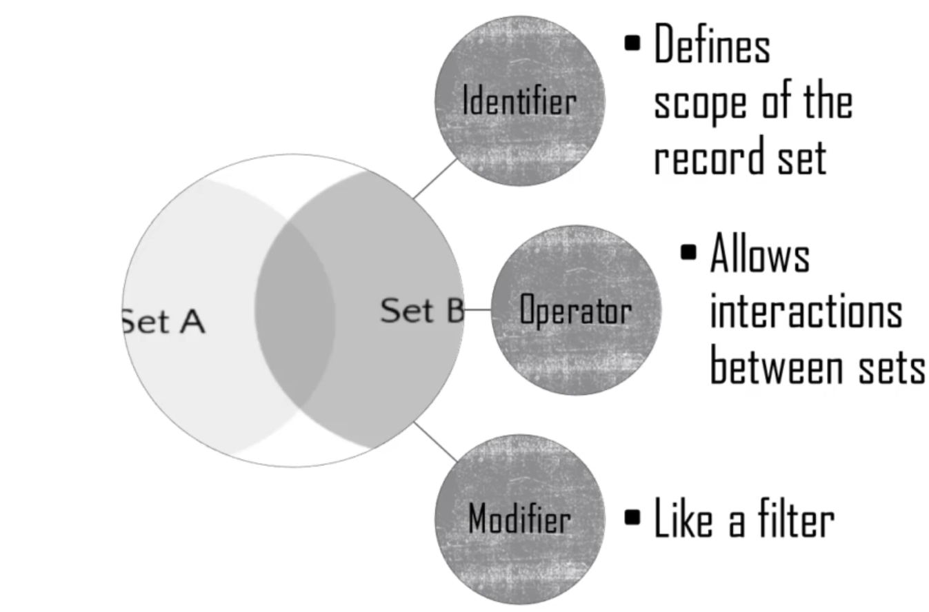

Slide 18
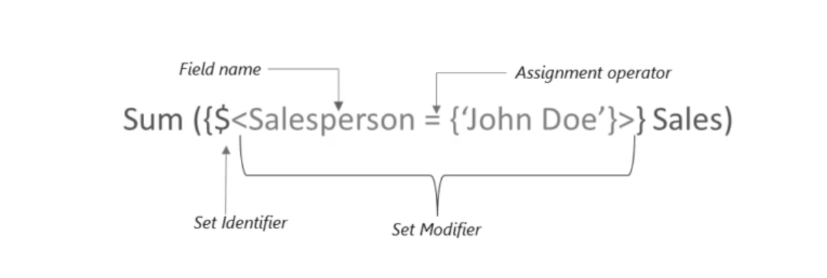

Slide 19
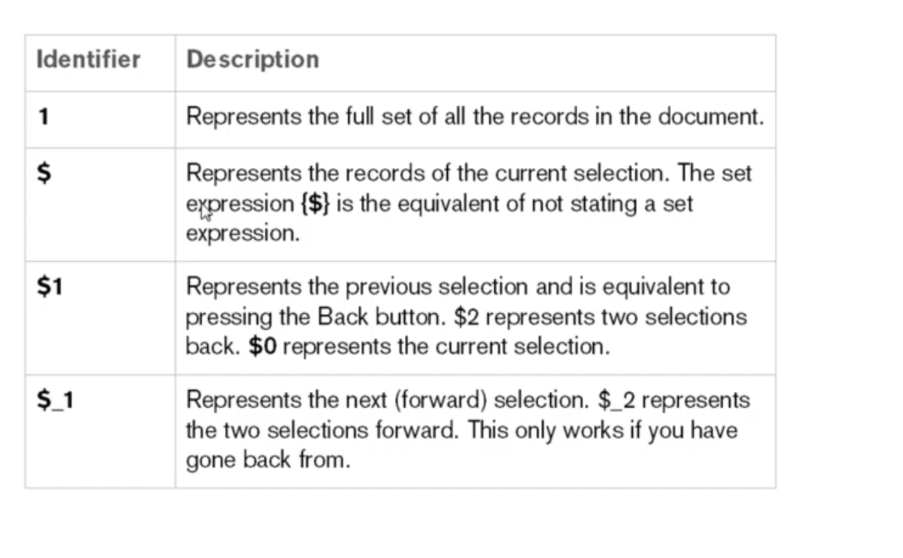

Slide 20
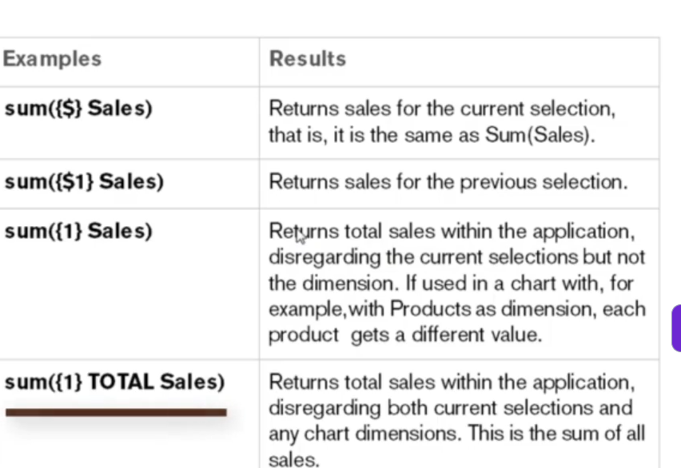

Slide 21
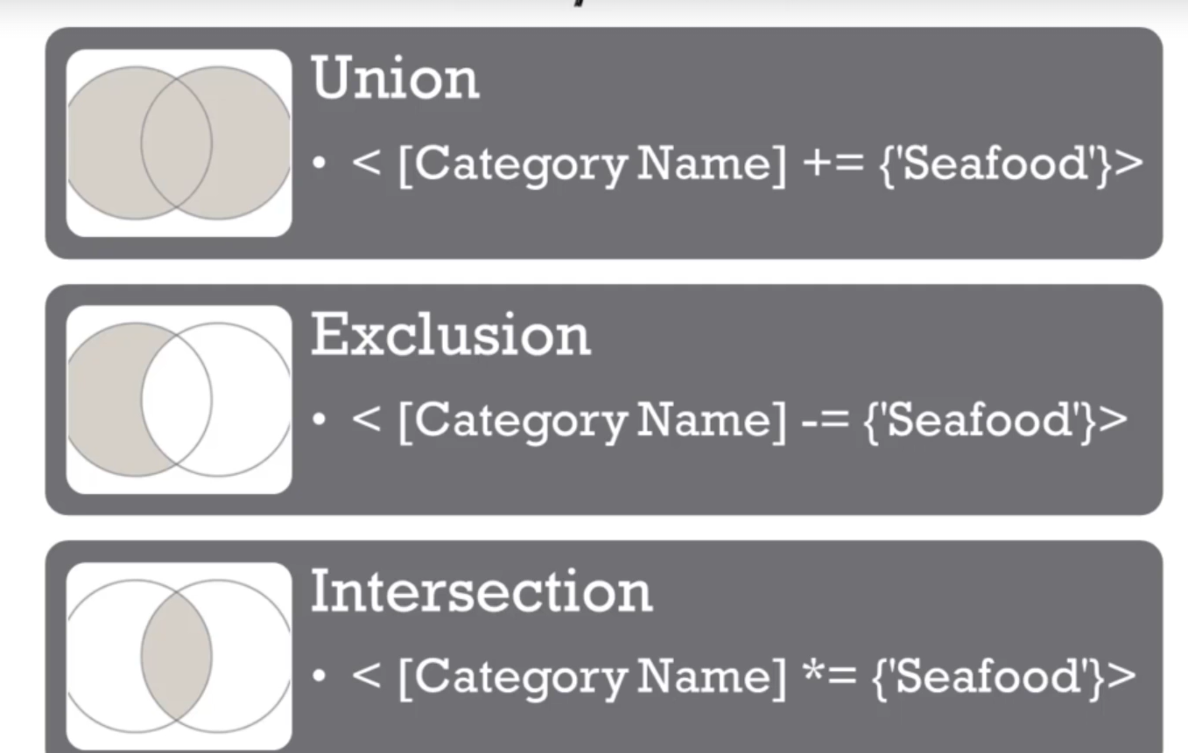

Slide 22
Why Do We Need Set Analysis?
Real Business Use Cases (Superstore Examples):
Comparison Analysis
  Compare "Sales in Selected Region" vs "Total Company Sales"
Year-over-Year (YoY) Comparison
  Show 2023 Sales vs 2022 Sales in the same chart, regardless of Year filter selected
Fixed KPIs
  Show "Total Profit for Technology Category" as a fixed KPI card, even if the user filters by Furniture
Excluding Specific Data
  Show Sales excluding "Returned" orders, regardless of other filters
Top Performer Analysis
  Show "Top 5 Customers Sales" regardless of current Region/Category filter

